Slide 1


Azərbaycan Dövlət Neft və Sənaye Universiteti
Calculus
Single Variable

Slide 2
Limits and Their Properties

Slide 3
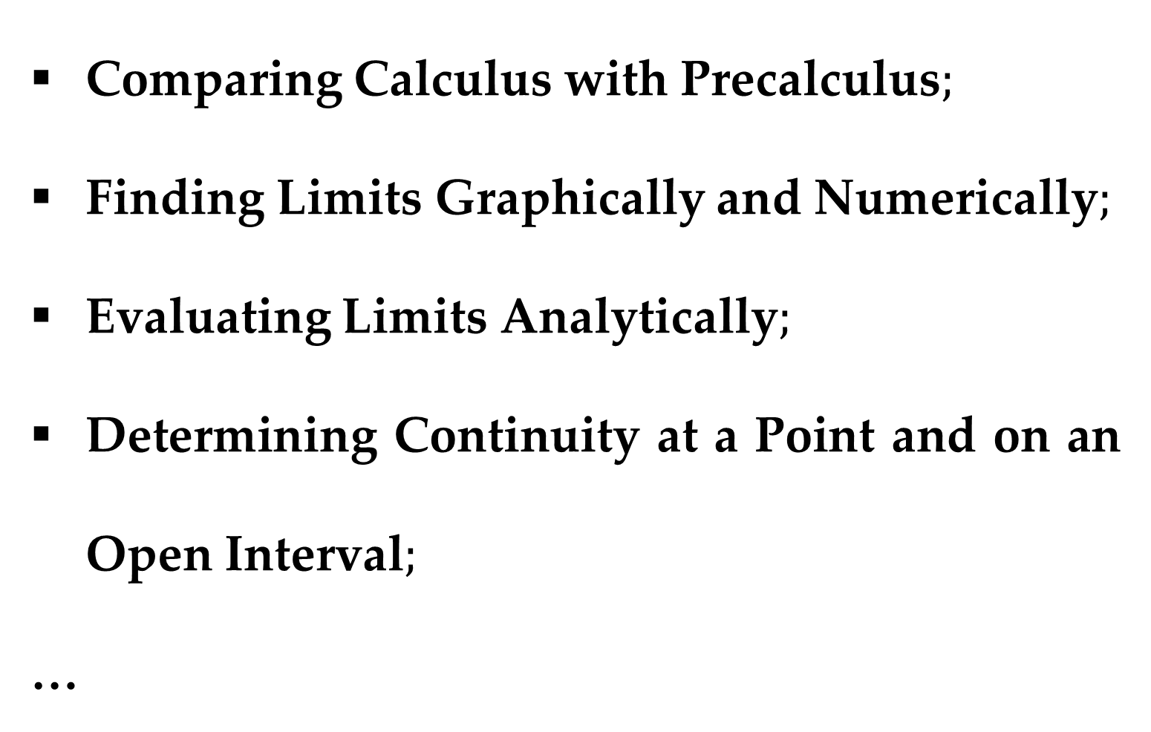
$$Outline$$
Comparing Calculus with Precalculus$;$
Finding Limits Graphically and Numerically$;$
Evaluating Limits Analytically$;$
Determining Continuity at a Point and on an Open Interval$;$
…

Slide 4
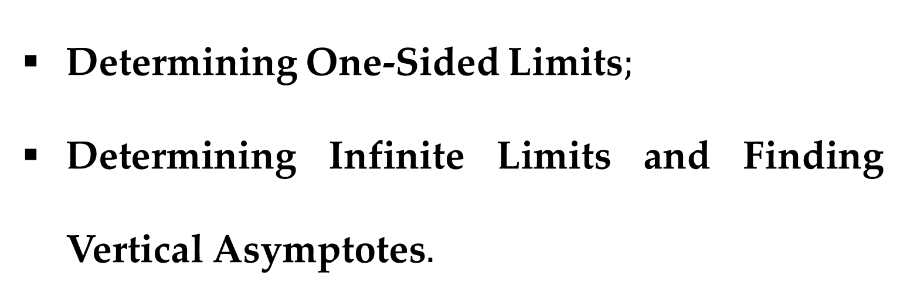
$$Outline$$
Determining One-Sided Limits$;$
Determining Infinite Limits and Finding Vertical Asymptotes$.$

Slide 5
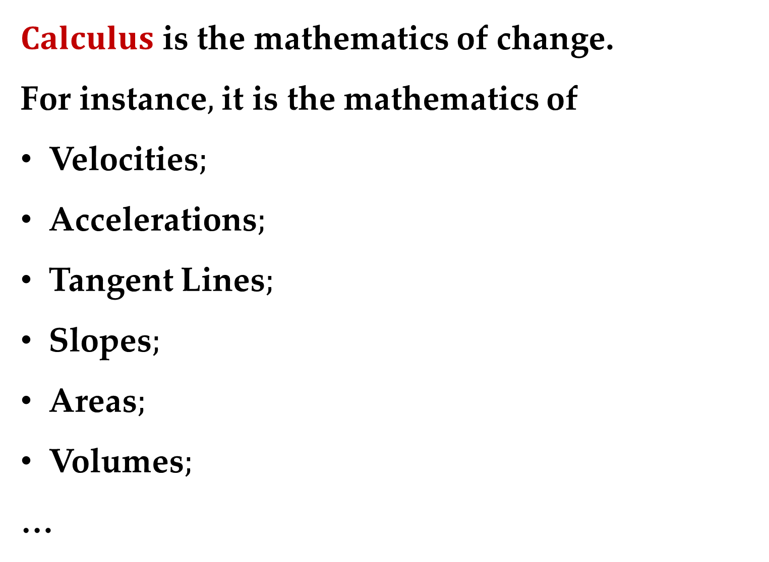
$Calculus$ is the mathematics of change.
For instance$,$ it is the mathematics of
Velocities$;$
Accelerations$;$
Tangent Lines$;$
Slopes$;$
Areas$;$
Volumes$;$
…
$What is Calculus?$

Slide 6
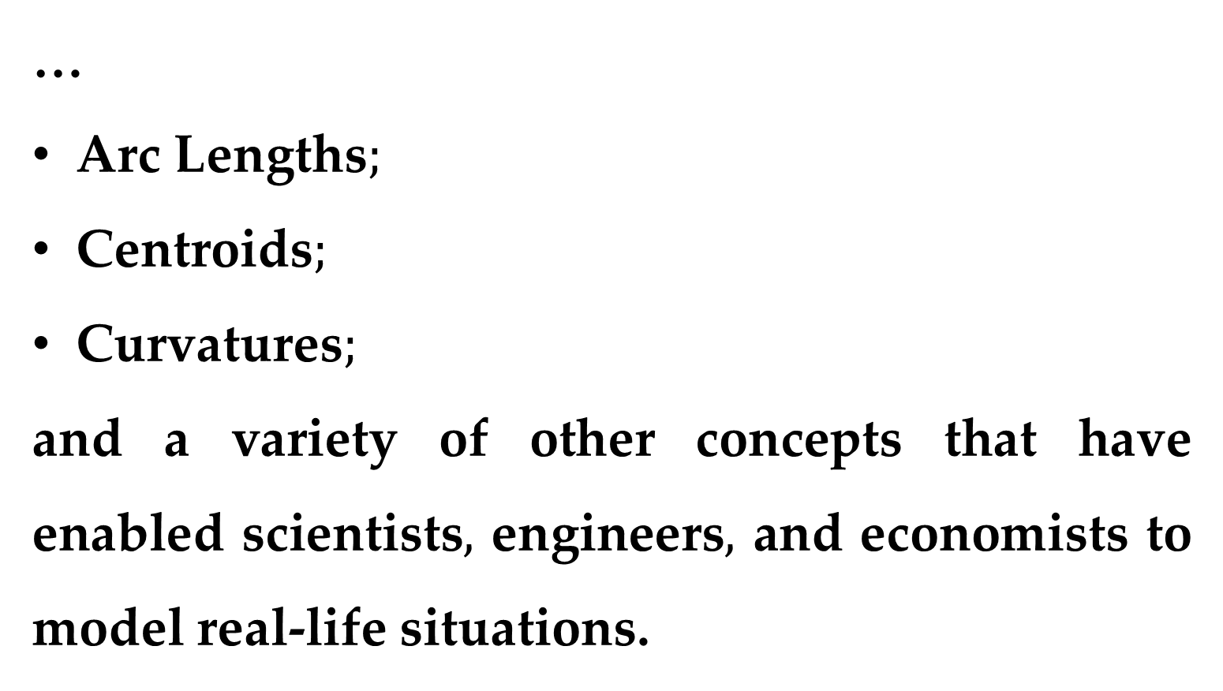
…
Arc Lengths$;$
Centroids$;$
Curvatures$;$
and a variety of other concepts that have enabled scientists$,$ engineers$,$ and economists to model real-life situations.

Slide 7
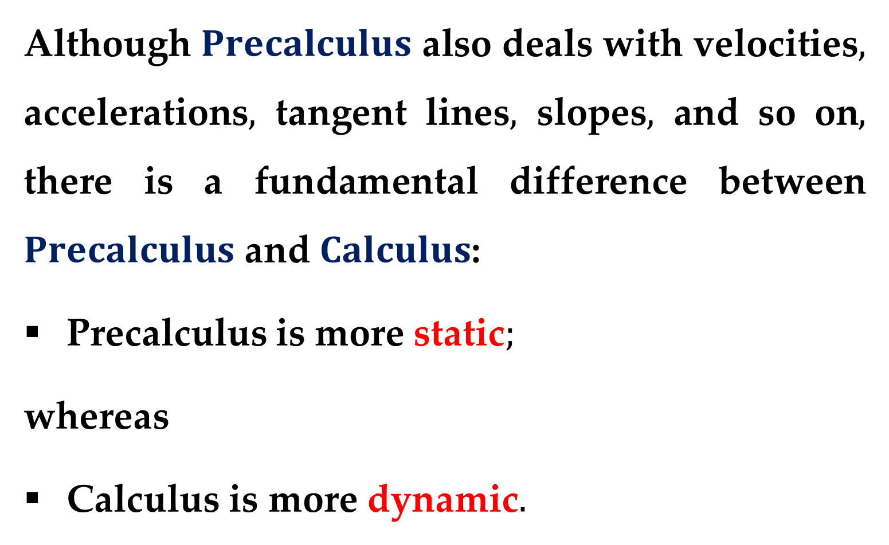
Although $Precalculus$ also deals with velocities$,$ accelerations$,$ tangent lines$,$ slopes$,$ and so on$,$ there is a fundamental difference between $Precalculus$ and $Calculus$:
Precalculus is more static$;$
whereas
Calculus is more dynamic$.$

Slide 8
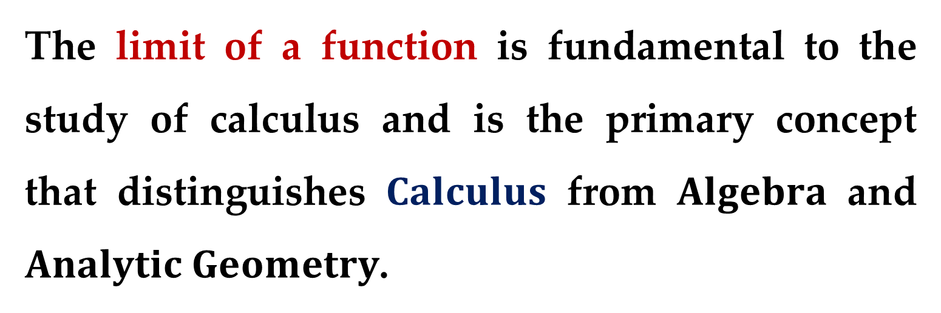
The limit of a function is fundamental to the study of calculus and is the primary concept that distinguishes $Calculus$ from $Algebra$ and $Analytic Geometry$.

Slide 9
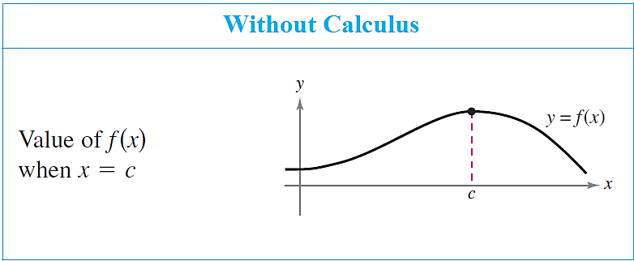
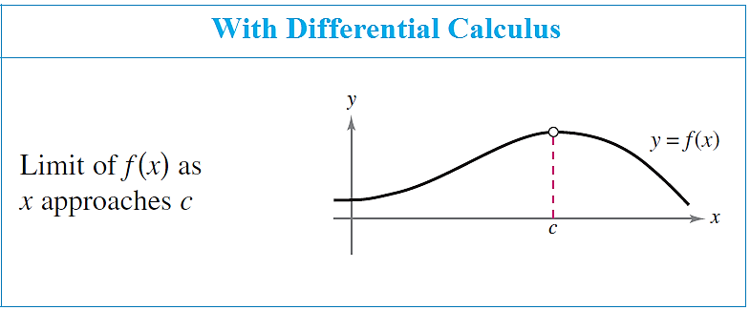
Calculus vs Precalculus

Slide 10
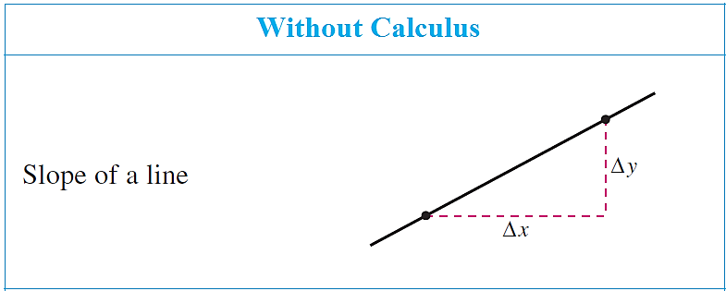
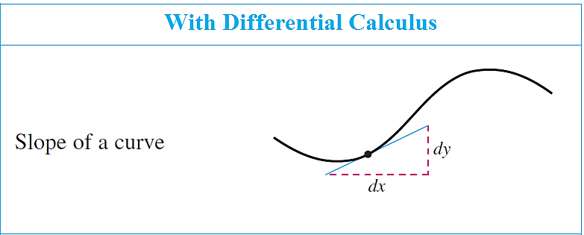
Calculus vs Precalculus

Slide 11
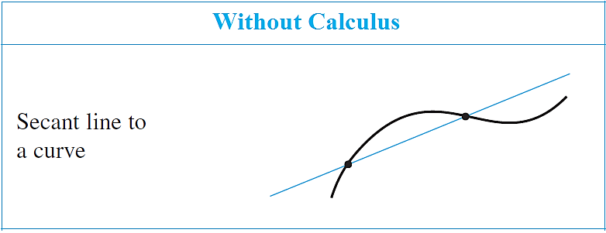
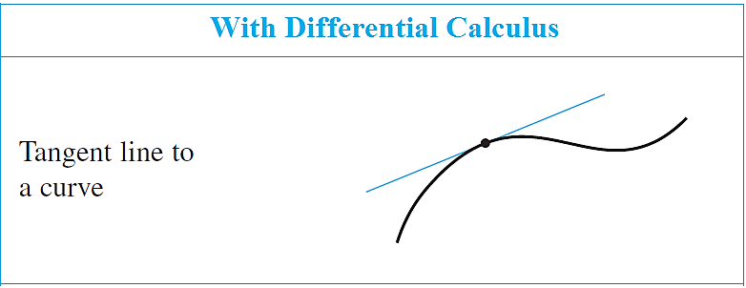
Calculus vs Precalculus

Slide 12
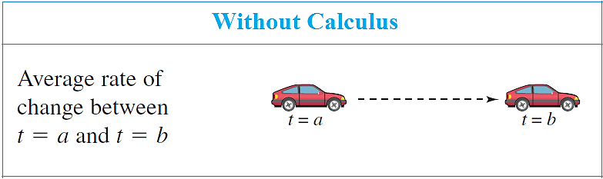
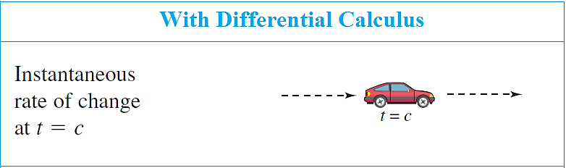
Calculus vs Precalculus

Slide 13
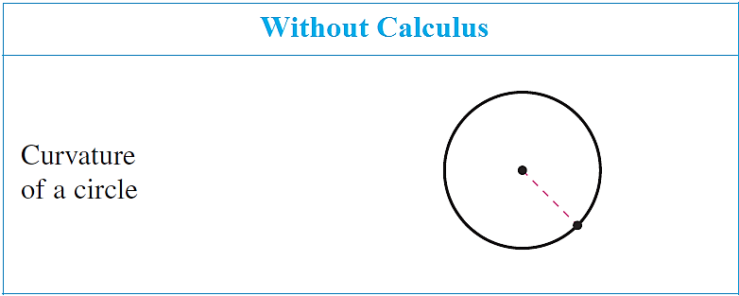
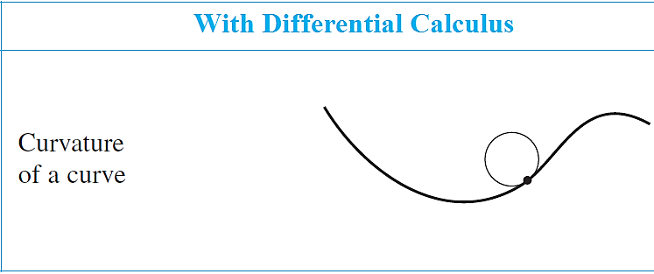
Calculus vs Precalculus

Slide 14
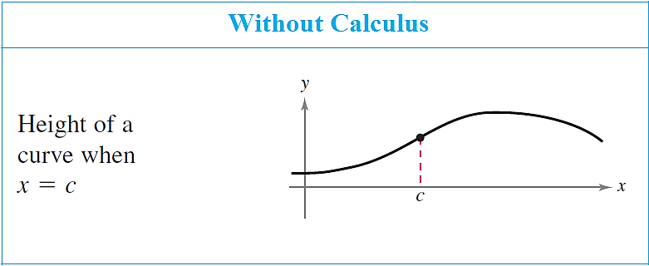
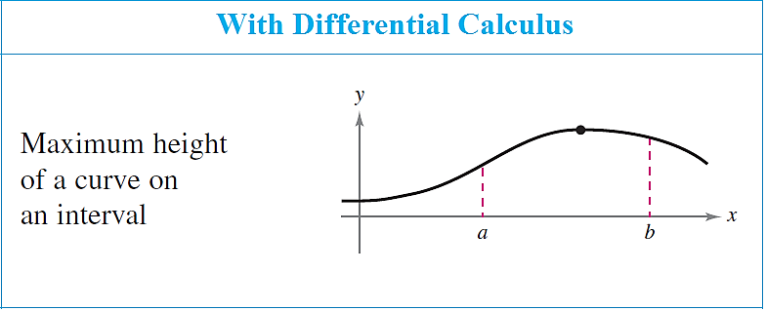
Calculus vs Precalculus

Slide 15
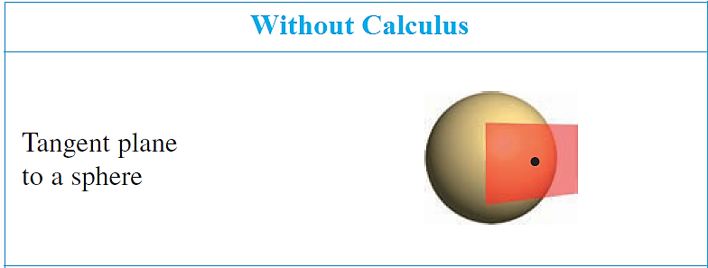
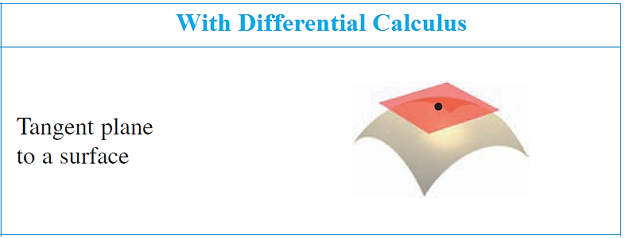
Calculus vs Precalculus

Slide 16
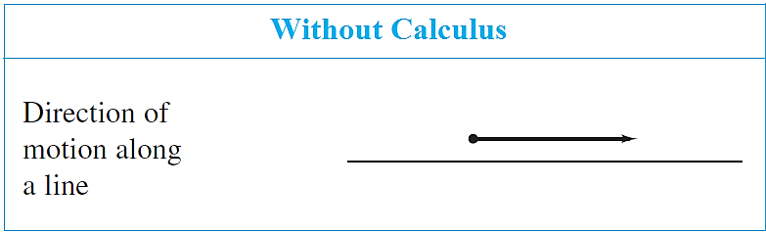
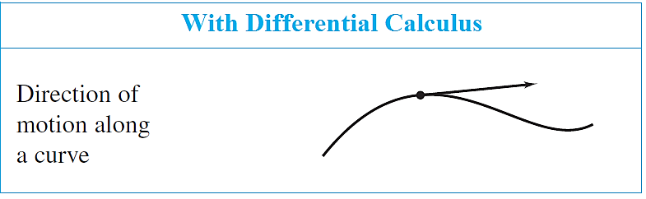
Calculus vs Precalculus

Slide 17
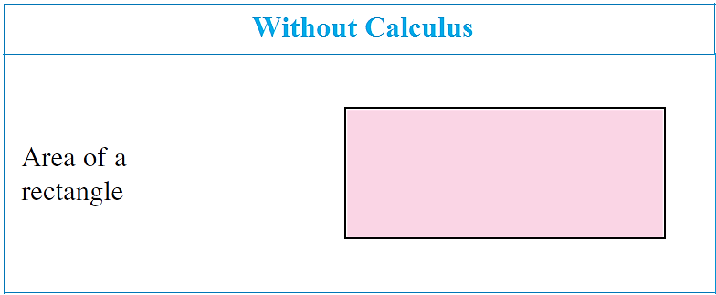
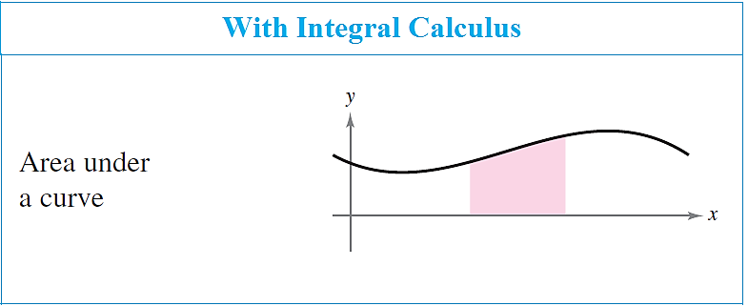
Calculus vs Precalculus

Slide 18
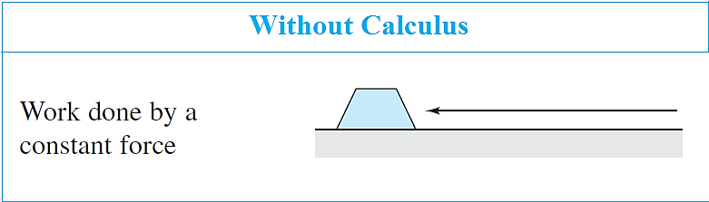
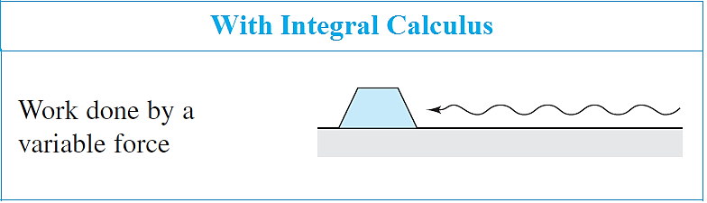
Calculus vs Precalculus

Slide 19
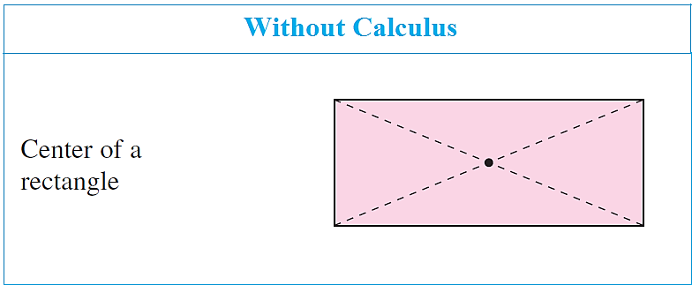
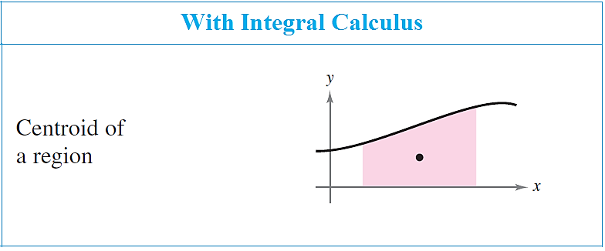
Calculus vs Precalculus

Slide 20
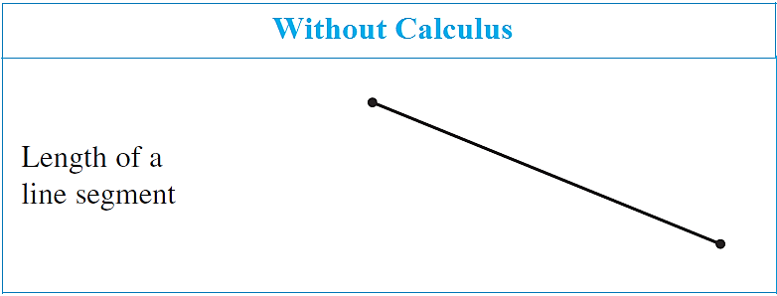
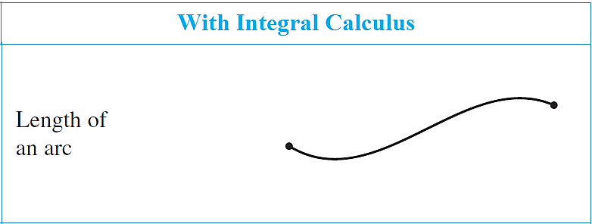
Calculus vs Precalculus

Slide 21
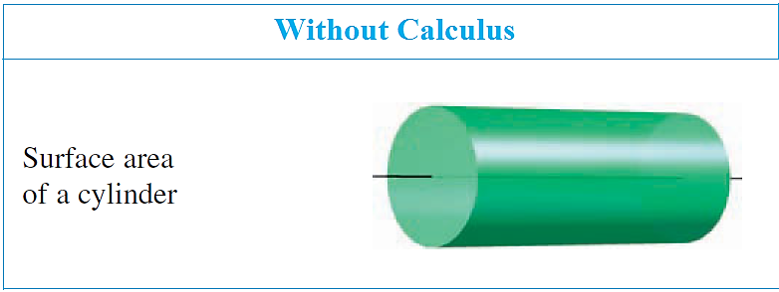
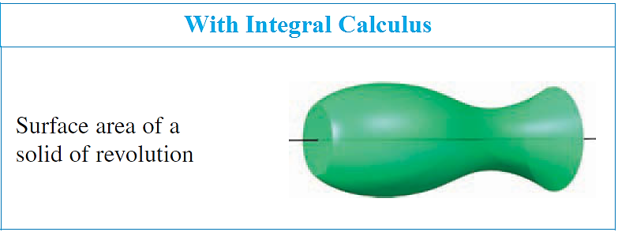
Calculus vs Precalculus

Slide 22
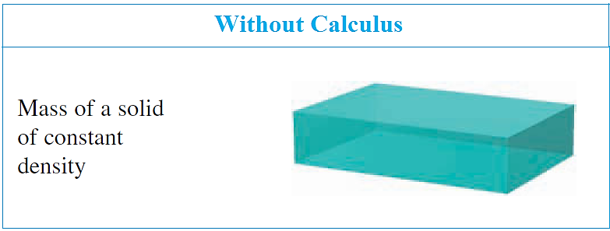
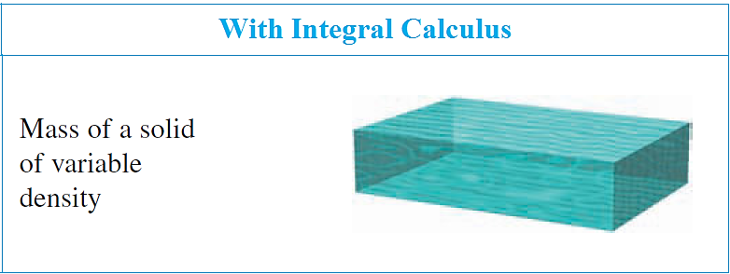
Calculus vs Precalculus

Slide 23
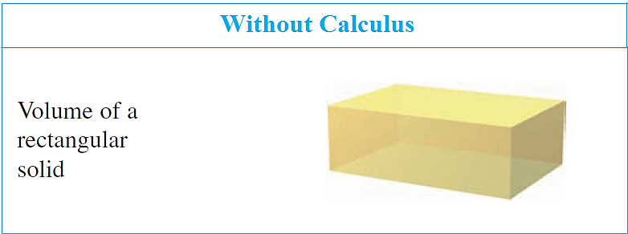
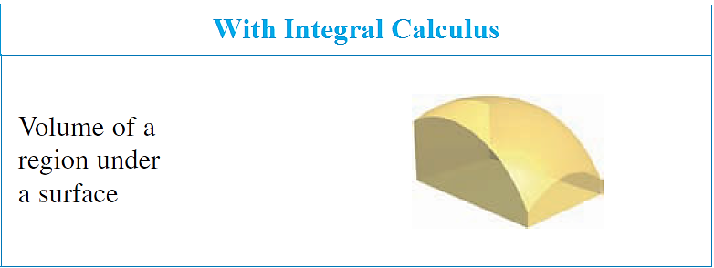
Calculus vs Precalculus

Slide 24
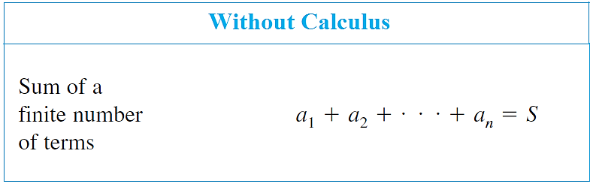
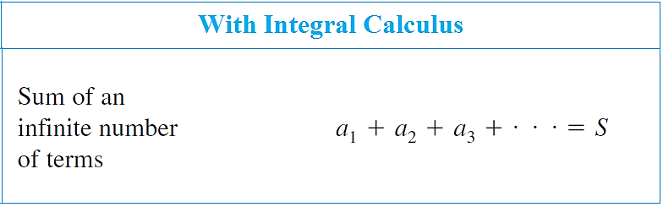
Calculus vs Precalculus

Slide 25
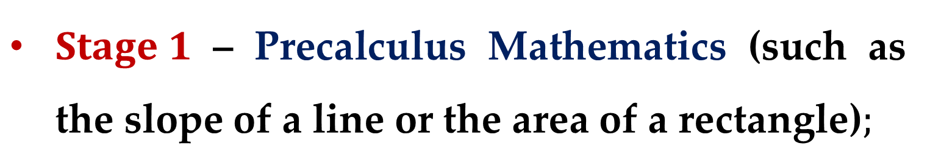
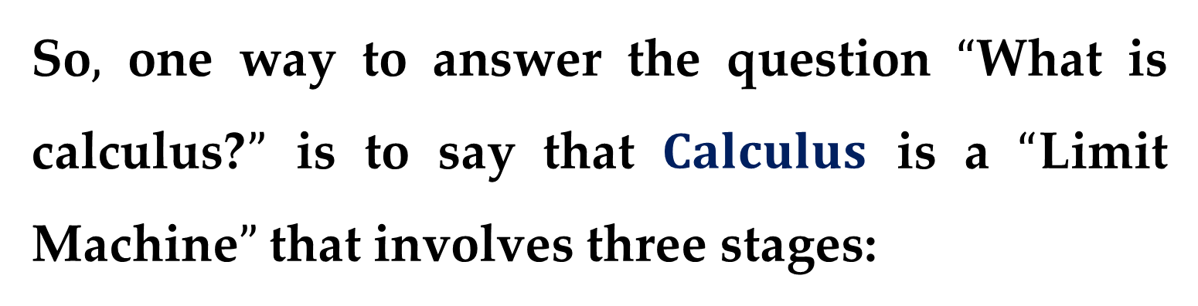
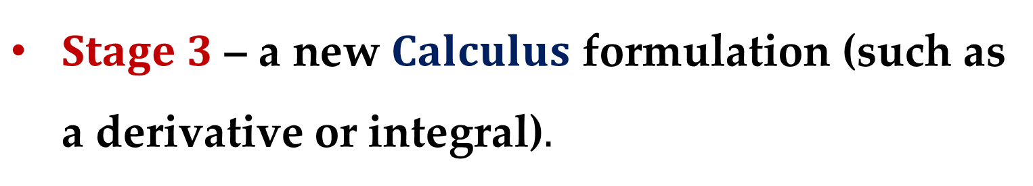
So$,$ one way to answer the question $“$What is calculus?$”$ is to say that $Calculus$ is a $“$Limit Machine$”$ that involves three stages:
$Stage 1$ – Precalculus Mathematics (such as the slope of a line or the area of a rectangle)$;$
$Stage 2$ – the $Limit Process;$
$Stage 3$ – a new $Calculus$ formulation (such as a derivative or integral)$.$

Slide 26

Your goal should be to learn how Precalculus formulas and techniques are used as building blocks to produce the more general Calculus formulas and techniques.

Slide 27
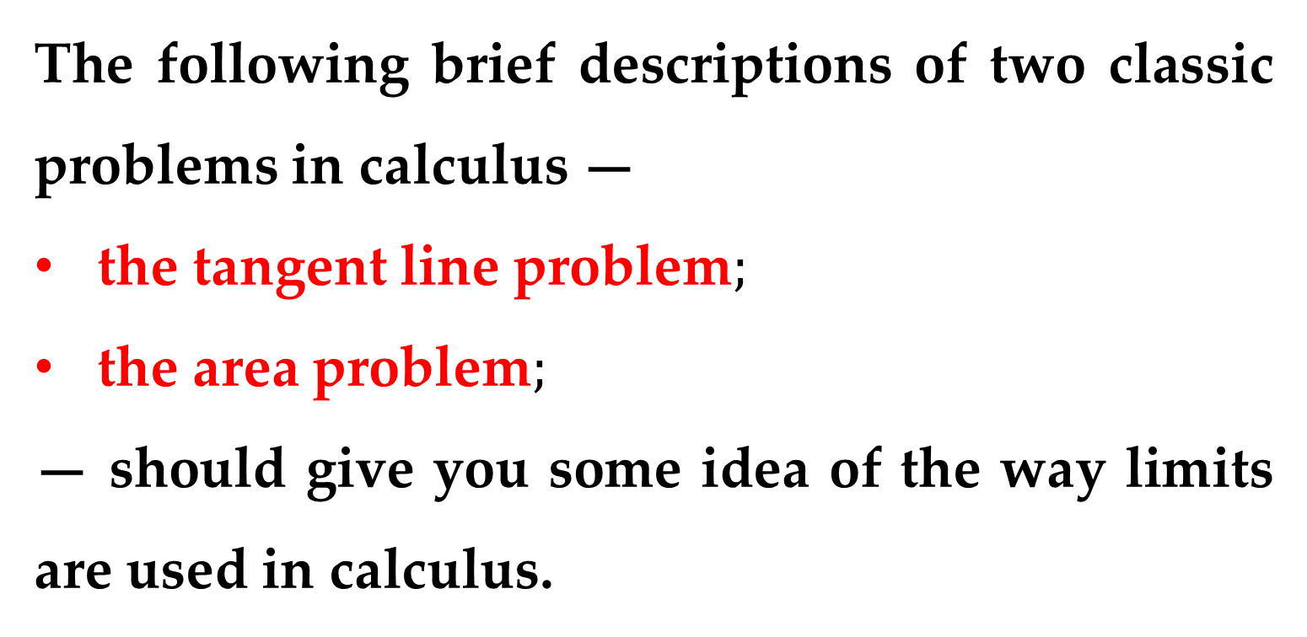
The following brief descriptions of two classic problems in calculus —
the tangent line problem$;$
the area problem$;$
— should give you some idea of the way limits are used in calculus.

Slide 28
The Tangent Line Problem

Slide 29
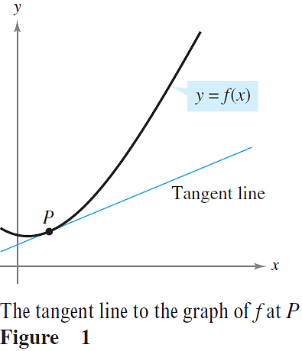
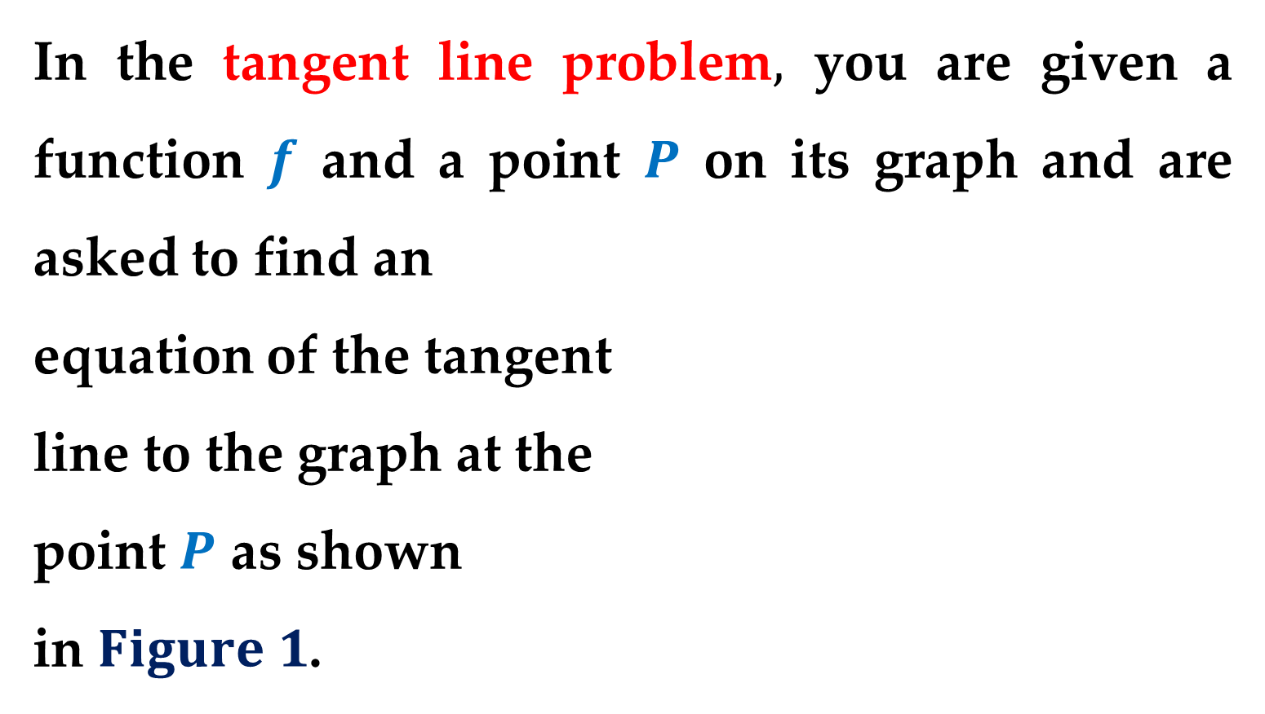
In the tangent line problem$,$ you are given a function $f$ and a point $P$ on its graph and are asked to find an
equation of the tangent
line to the graph at the
point $P$ as shown
in $Figure 1$.

Slide 30
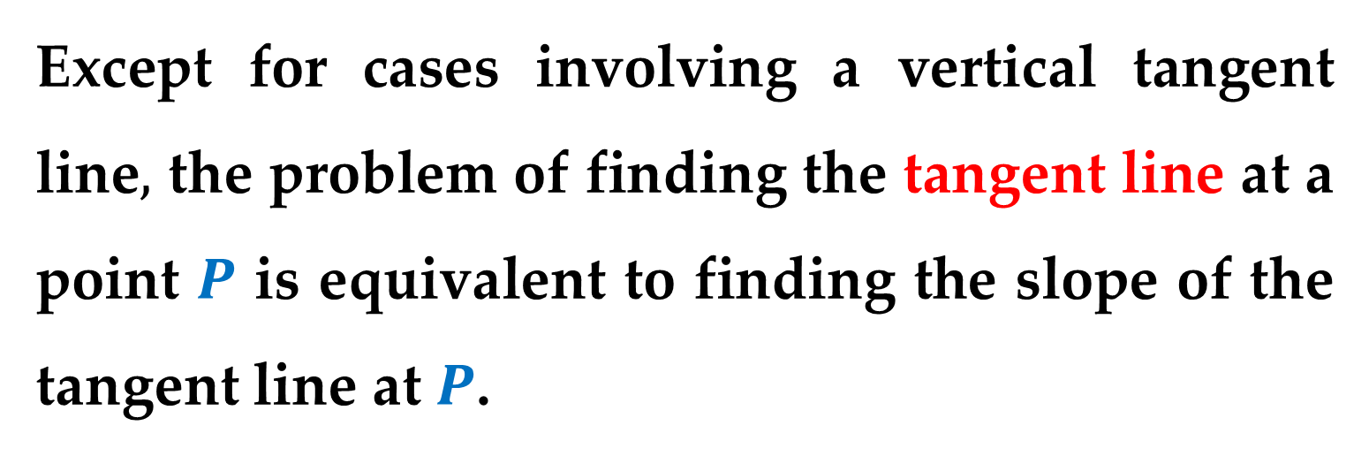
Except for cases involving a vertical tangent line$,$ the problem of finding the tangent line at a point $P$ is equivalent to finding the slope of the tangent line at $P$.

Slide 31
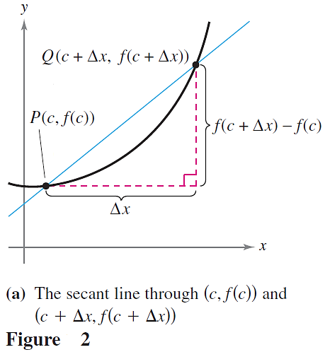
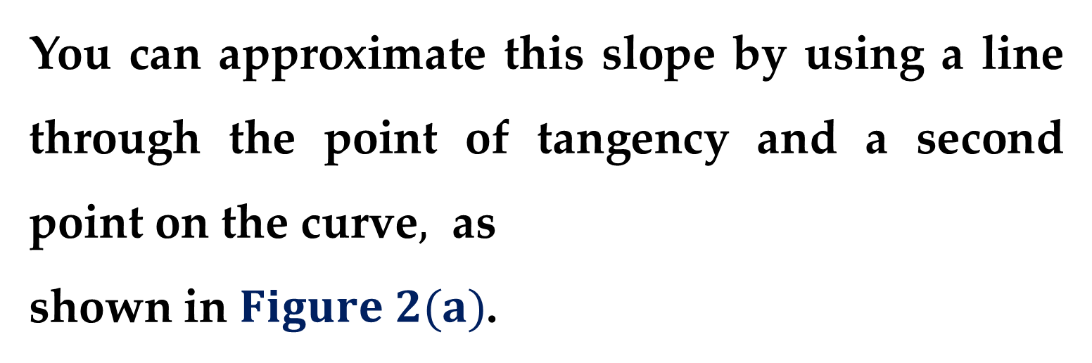
You can approximate this slope by using a line through the point of tangency and a second point on the curve$,$ as
shown in $Figure 2(a)$.
Such a line is called
a secant line.

Slide 32
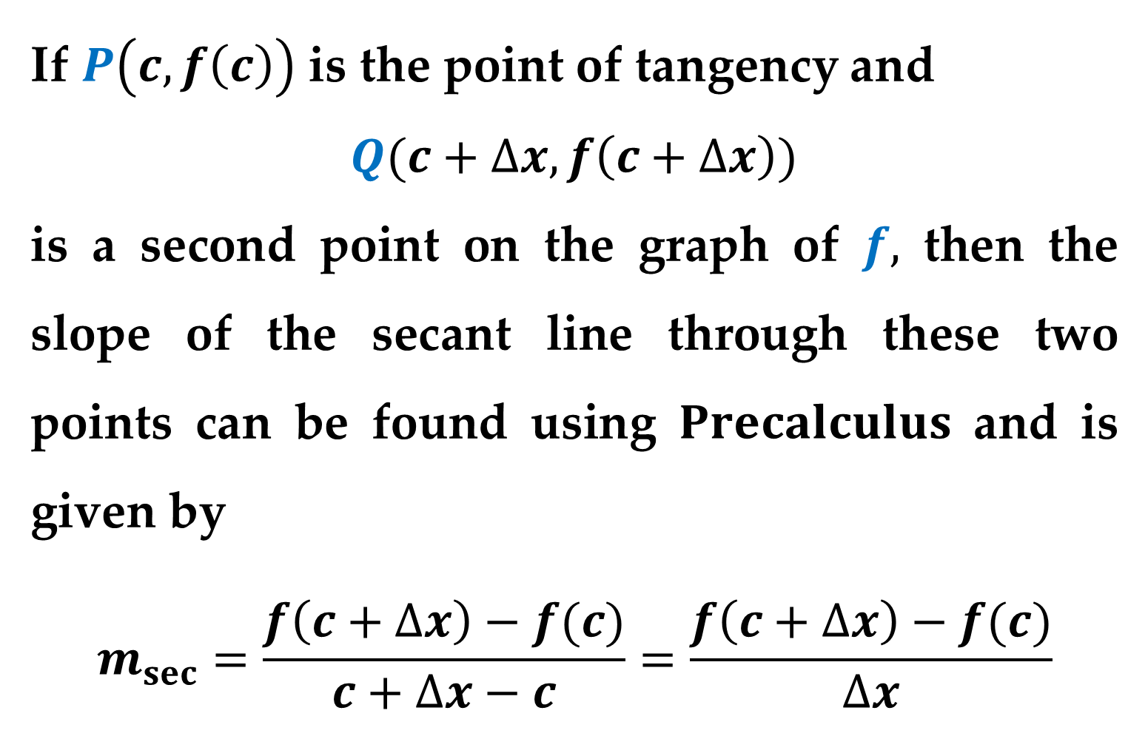
If $P\left(c,f\left(c\right)\right)$ is the point of tangency and
$Q(c+∆x,f\left(c+∆x\right))$
is a second point on the graph of $f,$ then the slope of the secant line through these two points can be found using $Precalculus$ and is given by
$$m_{sec}=\frac{f\left(c+∆x\right)−f(c)}{c+∆x−c}=\frac{f\left(c+∆x\right)−f(c)}{∆x}$$

Slide 33
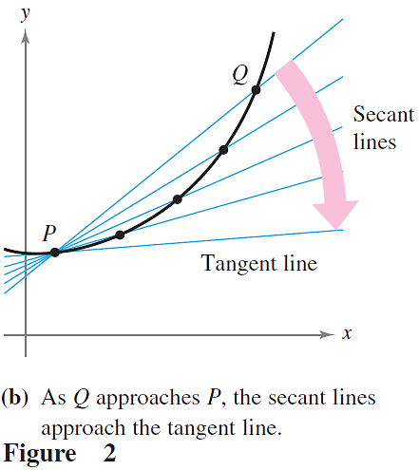
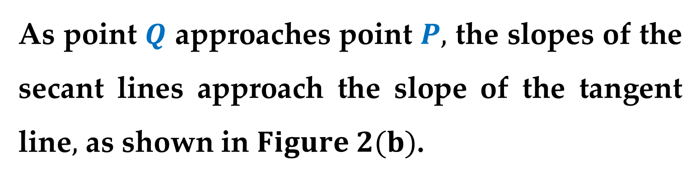
As point $Q$ approaches point $P,$ the slopes of the secant lines approach the slope of the tangent line$,$ as shown in $Figure 2(b)$.
When such a “limiting position” exists, the slope of the tangent line is said to be the limit of the slopes of the secant lines.

Slide 34
The Area Problem

Slide 35

A second classic problem in calculus is finding the area of a plane region that is bounded by the graphs of functions.
This problem can also be solved with a limit process.
In this case$,$ the limit process is applied to the area of a rectangle to find the area of a general region.

Slide 36


As a simple example$,$ consider the region bounded by the graph of the function $y=f\left(x\right),$ the $x−$axis$,$ and the vertical lines $x=a$ and $x=b$ as shown in $Figure 3$.

Slide 37


You can approximate the area of the region with several rectangular regions, as shown in $Figure 4$.

Slide 38


As you increase the number of rectangles, the approximation tends to become better and better because the amount of area missed by the rectangles decreases (see $Figure 5$).
Your goal is to determine the limit of the sum of the areas of the rectangles as the number of rectangles increases without bound.

Slide 39


$Example$
Consider the region bounded by the graphs of
$$f\left(x\right)=x^{2}, y=0, x=1$$
as shown in $Figure 6(a)$.

Slide 40

The area of the region can be approximated by two sets of rectangles —
one set inscribed within the region
the other set circumscribed over the region

Slide 41
Thank you for attention

